Slide 1
COM6103 Team Software Project
1st Sprint Meeting with Clients
NiceFace Project brief
presentation by team16
Client：Dr Li Sun
Advisor：Nada AbdelRahman
March 3, 2020

Slide 2
Overall Plan
1st sprint
2-4 week
Set up development environment(ROS, PyTorch , docker)
Research image recognition algorithms
Level out skills of team members
2nd sprint
5-7 week
Implement image recognition modules.
Compare performances of algorithms.
GUI, ROS controller.
3rd sprint
8-10 week
Add advanced features.
Bug fix and test.
System integration.
Prepare the slides.
Write up the draft of the final document.
11 week
4th sprint
Write up final report
Submission.

Slide 3
Task assignment
H
R
P
K
Y
Yuhan Hu: ROS,
planning documentation
Yuan Ru: communicator, Document editing
Chanho Park: ROS,
the algorithm
Qingyuan Yang: GUI, presentation, the docker
Renxiao Kuang: ROS, the algorithm

Slide 4
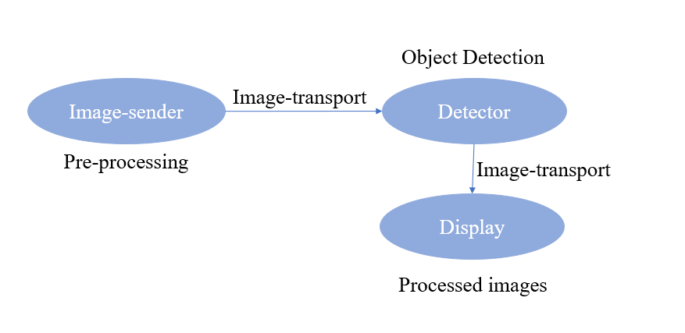
Project process
Convert data to image format,
Research models,
Faster R-CNN object detection with PyTorch
Confirm the project
Assign tasks and set learning tasks.
Week One
Week Two
Week Three
Week Four
Meeting to formulate project
Learn past cases, install the ROS, and process the data bag.

Slide 5
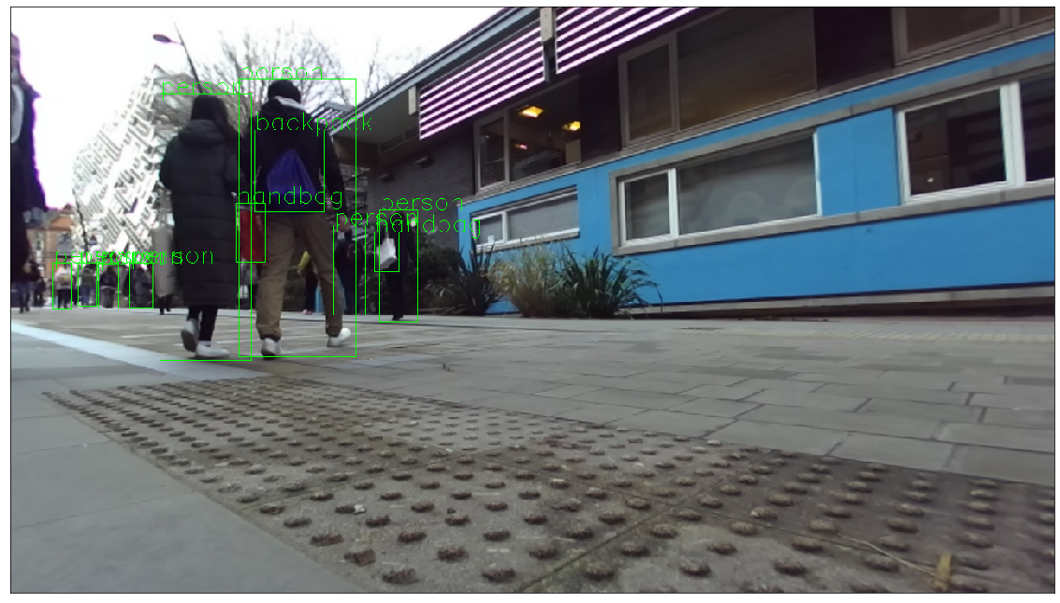
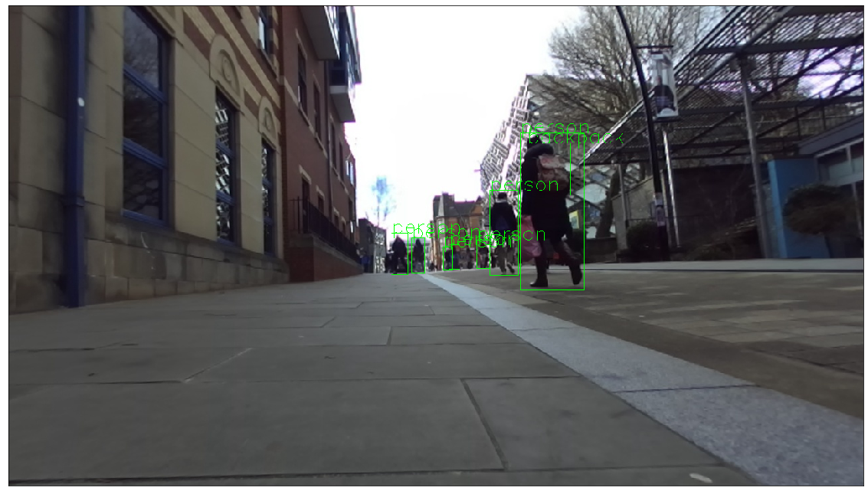
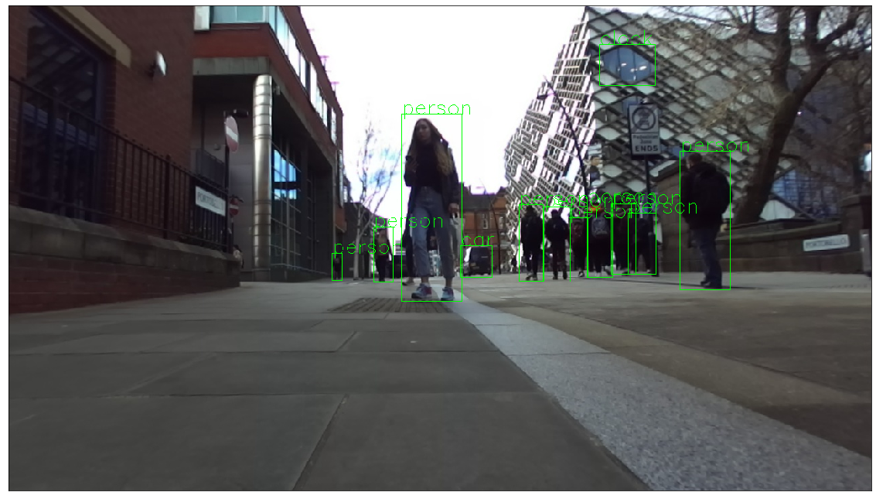
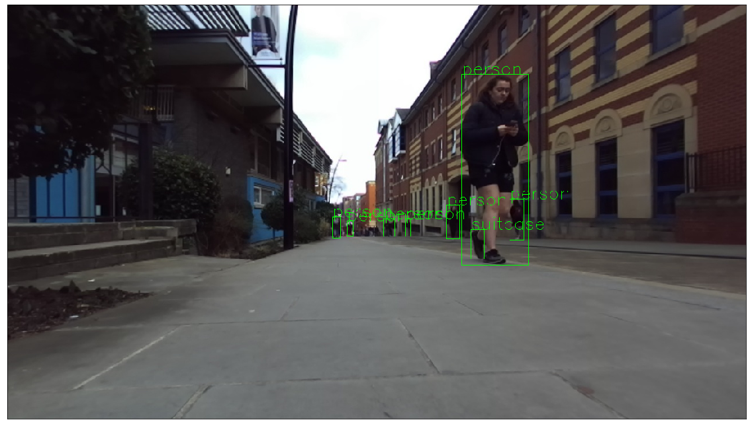
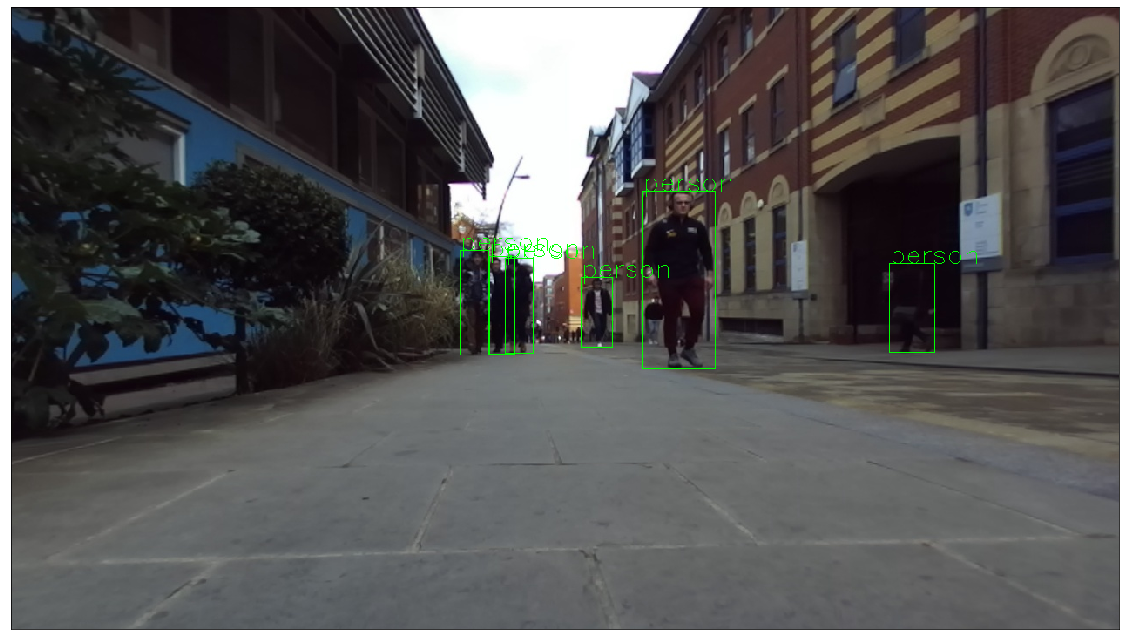
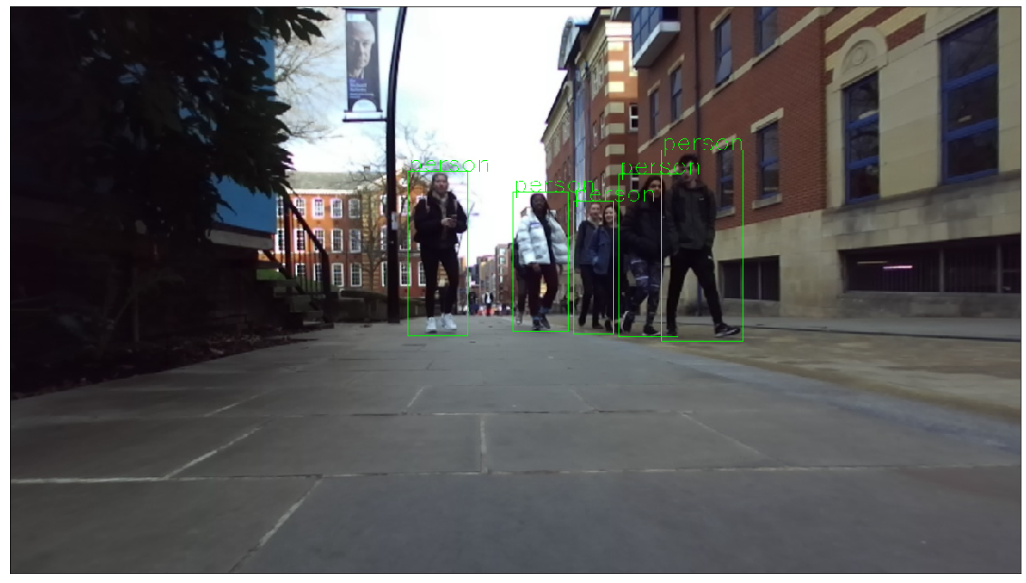
The result images
Faster R-CNN.
the result time: 8~10 seconds

Slide 6
Challenge and Solution
1. Some tools need to be mastered as soon as possible.
Using "LinkedIn Learning" through our Uni homepage.
2. System version limitation encountered while installing docker
Upgrade Windows to Windows10 pro
1. No suitable model has been found.
2. The algorithm we found was inefficient.
3. Run the algorithm model on the ROS.

Slide 7
THANK YOU

